Slide 1
UN Millennium Development Goals
Forecasting multiple time series using AutoRegressive models
Heather E. Adams
DS-DC-14
3 October 2016

Slide 2
The Question
Forecast change in indicators of U.N.’s eight goals, e.g. ensuring environmental sustainability, reducing child mortality
Hypotheses:
Worldwide macroeconomic indicators can be predicted from other collected data
Time series may be forecasted from past trends
https://www.drivendata.org/competitions/1/
Heather E. Adams

Slide 3
The Data
Competition on DrivenData, utilizes World Bank Open Data
Zipped CSV file
Training data are World Bank macroeconomic indicators (1972-2007) for 214 countries
Missing data
Predict 2008 and 2012 for 737 parameter series
1 to 6 parameters per country
Out of 195,402 parameters
E.g. “Generosity of All Social Protection,” “Net official flows from UN agencies,” and “Presence of peace keepers.”
http://data.worldbank.org/
Heather E. Adams

Slide 4
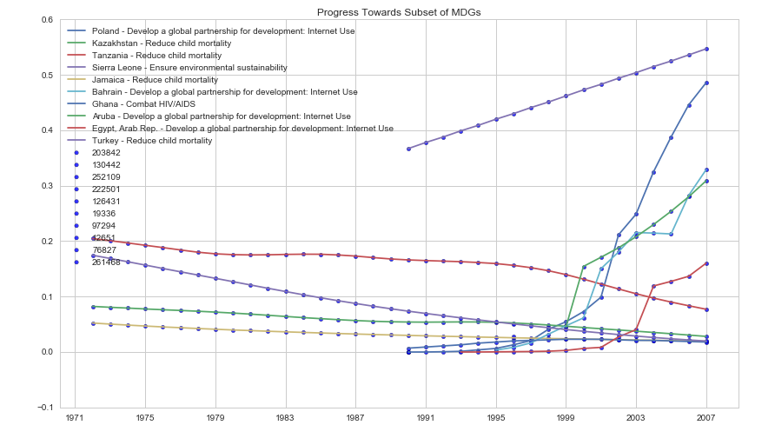
Exploratory Analysis
Heather E. Adams

Slide 5
Exploratory Analysis
All measures contain at least some missing values
.dropna() removes full dataset
Sierra Leone
Environmental sustainability
Lagged correlation matrix of data from single country
Most correlated with a change in “Gross National Expenditure” from the previous year.
However, goal is to predict 737 parameters
Exploratory graphs indicate most may be simple trends
Heather E. Adams

Slide 6
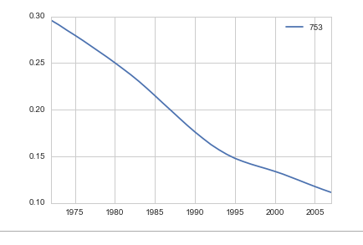
The Model
Time series AR Model
For a single series
Select years with data
AR model
Test/train split
Forecast 2008, 2012
Predicting test split of 2000-2007 for ‘753’ yielded mean absolute error of 0.015 when trained on 1972-1999.
Heather E. Adams

Slide 7
Scaling Up
Applying to entire dataframe
Prediction series only (737)
AR model
On data through 2007 to forecast 2008 and 2012
Discrete periods of data collection
1972-1989 (506 to 565 missing values)
1990-1995 (77 to 233 missing values)
1996-2007 (up to 80 missing values)
Replace missing data with series mean
Heather E. Adams

Slide 8
Model Evaluation
Prediction of 2008 and 2012 for 737 series
Submissions to DrivenData scored by root mean square error- all missing data replaced with series mean.
Training date range | Most missing data per year | RMSE | Convergence warnings
1972-2007 | 567 | 0.0930 | 33
1990-2007 | 233 | 0.0888 | 4
1996-2007 | 80 | 0.0806 | 14
ConvergenceWarning: Maximum Likelihood optimization failed to converge.
Heather E. Adams

Slide 9
Strengths and Weaknesses
Best root mean squared error: 0.0806
Rank 115 out of 909
Benchmarks
for status quo: 0.0734
for simple linear regression (uses data from 2006 and 2007 only) : 0.0678
Best submission so far: 0.0457
Problems:
Overlooks interactions with other parameters
Convergence issue
Heather E. Adams

Slide 10
Conclusions
Developed model that can be applied across the entire dataset
Largest impact
How missing data are handled
Confirms that the majority of the data can be subset to recent data
Simple models applicable
Interaction with other parameters to be determined
Heather E. Adams

Slide 11
Next Steps
4 months left in the competition, for glory
Moving forward
Optimize year range of training dataset
Missing value replacement method
Address convergence issue
Alternate model
Random forest with interactions from the larger data set
Heather E. Adams

Slide 12
Acknowledgements
Alex Egorenkov
John Tate
DrivenData
General Assembly
Stack Overflow
Heather E. Adams

